Slide 1

IoT-Enabled and Head-Gesture-Controlled Autonomous Wheelchair Navigation
CSE 4000
Presented by,
Md. Masudur Rahman Rabbi
Roll: 1907113
Protya Roy
Roll: 1907025
Department of Computer Science and Engineering
Khulna University of Engineering & Technology
Supervised by,
Dr. Muhammad Sheikh Sadi
Professor
Department of Computer Science and Engineering
Khulna University of Engineering & Technology
30.08.2025

Slide 2
Outlines
Introduction
Objectives
Literature Review
Hardware Components
Methodology
Experimental Analysis
Demonstration
Future Works
Conclusions
References
30.08.2025

Slide 3
Introduction
Traditional wheelchair controls are difficult for users with severe disabilities.
Head gestures: natural head tilts (F/B/L/R) as commands.
Gyro sensor: detects rotation and orientation to track head movements.
Combines for smooth, hands-free navigation, enhancing independence and accessibility.
30.08.2025

Slide 4
Objectives
The main objectives are to:
develop a hands-free wheelchair control system using head gestures.
utilize gyro(MPU6050) sensor for precise motion detection.
enable smooth navigation in multiple directions.
improve mobility and independence for physically disabled users.
ensure safety, accessibility, and ease of use.
30.08.2025

Slide 5
Literature Review
Table 1 : Summary of Head-Gesture-Controlled Wheelchair Studies
Author name | Method | Findings | Limitations
Azraai, Mohd. et al. [1] | Gyro + microcontroller | Accurate detection, smooth move | Only tested on healthy users
Rahman, M. M. et al. [2] | Accelerometer + Arduino + sensors | Multi-direction, obstacle safety | High cost, complex hardware
Kumar, A. et al. [3] | MPU6050 + wireless | Wireless, improved independence | Prototype only, no validation
Priyatharshini, R. et al. [4] | Accelerometer + GSM | Health monitoring, alerts | Complex, GSM dependency
Ahmed, F. et al. [5] | Gesture + health monitoring | Mobility + safety + health track | Very complex, heavy compute
30.08.2025

Slide 6
Hardware Components
Arduino UNO
1602 LCD display
MPU6050 gyro sensor
Wheelchair chassis
Wheel Chair
DS18B20 temp. sensor
24V Li-ion battery
ESP32
Emergency circuit breaker
BTS motor driver
DC motor
Fig 1 : Hardware components for wheelchair
30.08.2025

Slide 7
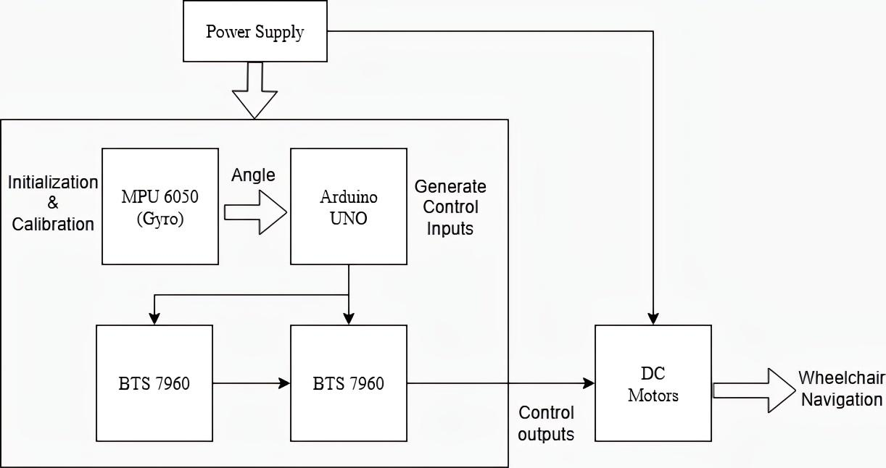
Methodology
Fig 2 : Block Diagram of the Head-Gesture-Controlled Wheelchair Navigation

Slide 8
Methodology (Cont.)
Wheelchair Movement (Steps)
Step 1: Calibration of MPU6050
Step 2: MPU6050 measures head tilt along X, Y, Z axes
Step 3: Tilt thresholds mapped to commands:
Forward: X > +20° → move forward
Backward: X < −20° → move backward
Right: Y > +20° → left motor forward, right motor backward
Left: Y < −20° → left motor backward, right motor forward
Stop: X and Y within ±20° → all motors stop
Fig 2 : Block Diagram of the Head-Gesture-Controlled Wheelchair Navigation
30.08.2025

Slide 9
Methodology (Cont.)
Wheelchair Movement (Steps)
Step 4: Arduino/ESP32 sends PWM signals to motor driver (BTS7960), controlling speed and direction
Step 5: Continuous loop updates motor commands every 10 ms for smooth, real-time response
Dead Zone: Small tilts (±5°) ignored to avoid unintended movement
Fig 2 : Block Diagram of the Head-Gesture-Controlled Wheelchair Navigation
30.08.2025

Slide 10
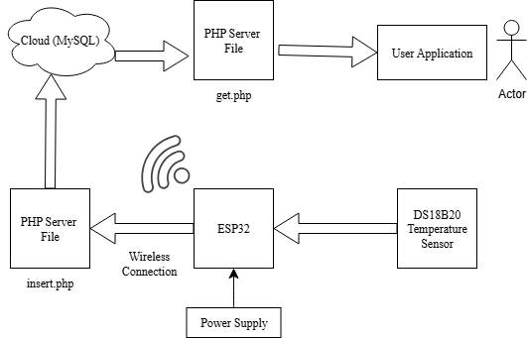
Methodology (Cont.)
IoT Based Body Temperature Monitoring
Dedicated ESP32 collects DS18B20 temperature data independently of wheelchair control.
Data sent via Wi-Fi to MySQL database using insert.php.
User app retrieves real-time or historical temperature via get.php.
Fig 3 : Block diagram of IoT based body temperature monitoring via cloud(MySQL)
30.08.2025

Slide 11
Methodology (Cont.)
IoT Based Body Temperature Monitoring
Local 1602 LCD displays immediate temperature feedback.
Separation ensures wheelchair navigation remains safe and unaffected.
Provides remote health monitoring and reliable operation for the patient.
Fig 3 : Block diagram of IoT based body temperature monitoring via cloud(MySQL)
30.08.2025

Slide 12
Experimental Analysis
Performance Testing
Compared Head Gesture, Joystick, and Voice Control.
Tested in indoor, ramps, outdoor, long-term use, and complex tasks.
Key Findings
Head Gesture: Best in narrow spaces, sharp turns, straight paths.
Joystick: Most stable & versatile, especially in long navigation & zigzag paths.
Voice Control: Works on smooth floors, but unreliable in noisy environments & causes fatigue.
30.08.2025

Slide 13
Experimental Analysis (Cont.)
Table 2 : Performance Comparison of Control Methods
Scenario | Head Gesture(HG) | Joystick(JS) | Voice Control(VC) | Verdict
Indoor | Accurate, safe | Stable | Delay issues | HG best
Ramp/Surface | Fast, smooth | Consistent | Needs quiet env. | HG best
Outdoor | Slight tilt issue | Stable | Affected by noise | JS best
Long-term Use | Minor neck strain | No fatigue | Voice fatigue | JS best
Task/Speed | Fast in straight/turns | Best in zigzag paths | Slow | Both HG and JS best
30.08.2025

Slide 14
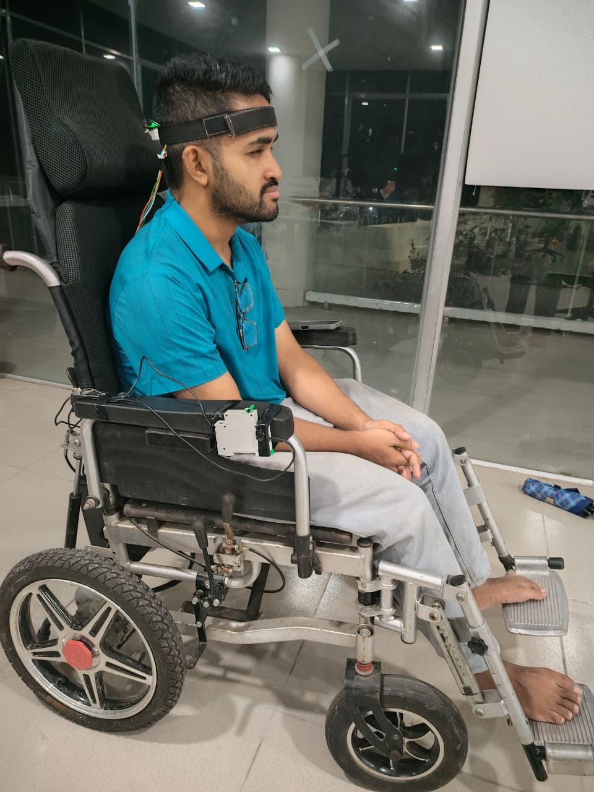
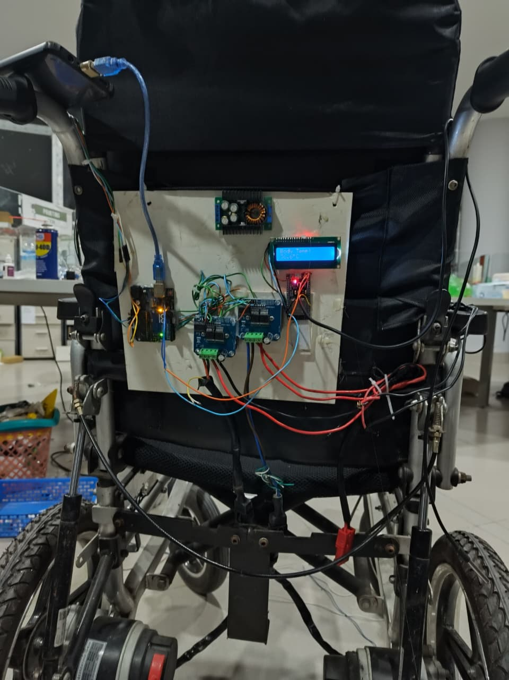
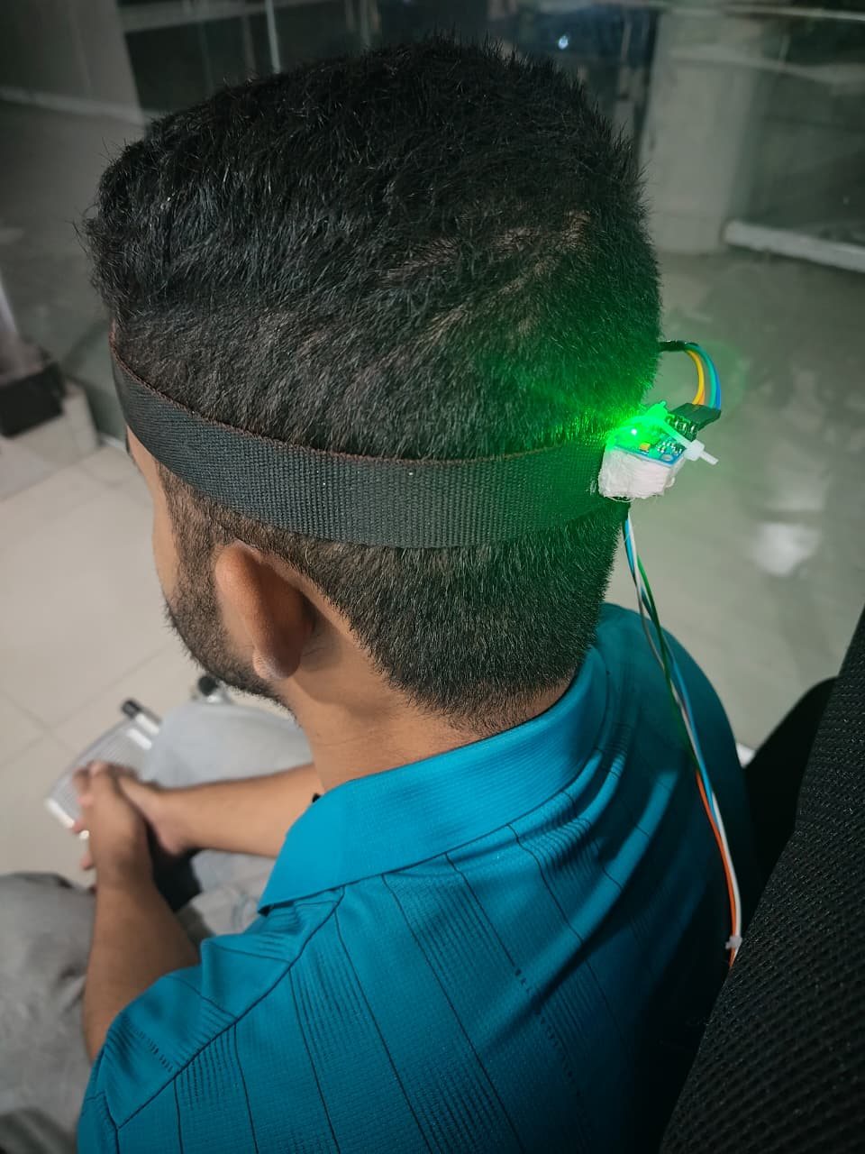
Demonstration
(a) (b) (c)
Fig 4: (a) Full demonstration, (b) Circuit connections, (c) MPU6050 mounted on headband

Slide 15
Future Works
Integrating obstacle detection and avoidance sensors for safer navigation.
Adding advanced health monitoring(heart rate, fall detection)alongside temperature.
Implementing machine learning for adaptive gesture recognition & smoother control.
Exploring solar-powered or energy-efficient systems for longer operational time.
30.08.2025

Slide 16
Conclusions
Head gesture-controlled wheelchairs provide hands-free, intuitive mobility.
Gyro sensors enable accurate and responsive navigation.
IoT integration allows real-time health monitoring and cloud data storage.
The system enhances independence, accessibility, and user safety.
Future enhancements can further improve usability, intelligence, and energy efficiency.
30.08.2025

Slide 17
References
[1] M. A. Mohd Azraai, S.Z. Yahaya, I. Almanzo Chong, Z.H. Che Soh, Z. Hussain and R. Boudville. “Head gestures based movement control of electric wheelchair for people with tetraplegia”, 2022 IEEE 12th International Conference on Control System, Computing and Engineering (ICCSCE), pages 163–167, 2022.
[2] Prannah Dey, Md.Mehedi Hasan, Srijon Mostofa, and Ariful Islam Rana. “Smart wheelchair integrating head gesture navigation”, 2019 International Conference on Robotics,Electrical and Signal Processing Techniques (ICREST), pages 329–334, 2019.
[3] Shivamma D, Manjula M, S Bhavani Prasad, Nikunj Vihari Konakalla, Eshwar Reddy M, and Mir Khyrun Ali. “Smart wheelchair navigation using gesture-based control and iot”, 2025 International Conference on Intelligent and Innovative Technologies in Computing, Electrical and Electronics (IITCEE), pages 1–4, 2025.
[4] Pravin Kumar Sah, Chandra Harsha, Hemanth Dinesh, Nithin Ratkonda, and Lekshmi Vijayan. “Head gesture controlled wheelchair with integrated health monitoring for paralysis patients”, 2024 8th International Conference on I-SMAC (IoT in Social, Mobile, Analytics and Cloud) (I-SMAC), pages 1204–1210, 2024.
[5] Mrunal Patil, Mansi Subhedar, Yash Kamble, and Omkar Labde. “Intelligent wheelchair design: Integrating gesture recognition, health tracking and fall detection”, 2024 8th International Conference on Computing, Communication, Control and Automation (ICCUBEA), pages 1–6, 2024.
30.08.2025

Slide 18
Thank You

